Slide 1
AVIATION HEAT FLUX CALIBRATION STANDARD
2019 Triennial International Fire & Cabin Safety Research Conference
Atlantic City, NJ USA
Michael Burns, FAA Tech Center
October, 2019

Slide 2
AGENDA
History
Aviation Heat Flux Calibration Standard
  Specification, Method & Procedures
Comparative Test Data
Q & A

Slide 3
BRIEF HISTORY
06/08 – Discovery of Heat Flux Gage Calibration Discrepancy
Visit to Manufacturers / NIST
06/09 – International Heat Flux Gage Calibration Study
Industry Submitted Gages To FAA Technical Center For Calibration Comparison
07/09 – Heat Flux Sensitivity Study Using Gages Installed In Test Apparatus (HRR, NBS Smoke Density & Radiant Panel tester)
10/09 – Sensitivity Study
Effect On Data By Varying Heat Flux Levels
10/10 – Development Of Interim Aviation Heat Flux Gage Calibration Standard
11/12 – Development Of Aviation Heat Flux Gage Calibration Standard

Slide 4
Aviation Heat Flux Calibration Standard
introduction
Transfer of National Institute of Standards and Technology (NIST) Primary heat flux calibrations to total heat flux gauges used in flammability testing of aircraft materials.
Apparatus:
  Reference heat flux gauge
  Radiant heat source capable of producing flux levels up to 5 W/cm²
  Precision alignment system
  Data acquisition system

Slide 5
Aviation Heat Flux Calibration Standard
Definitions
Heat Flux: The rate of thermodynamic energy transfer per unit area that is incident on a material (W/cm² or BTU/ft²*sec).
Heat Flux Gauge (HFG): A transducer used in determining heat flux levels.
NIST: National Institute of Standards and Technology (USA). The NIST is considered the owner of the Primary Heat Flux Standard.

Slide 6
Aviation Heat Flux Calibration Standard
Calibration Factor (Scale Factor): The calibration factor is a constant multiplier that converts an HFG’s millivolt signal to the measured value of heat flux.
It is derived from incident flux (W/cm²/mV). The responsivity or sensitivity is the reciprocal of the calibration factor.
Secondary Standard HFG: The Secondary Standard HFG is calibrated by NIST using their heat-flux calibration service. This gauge is used to transfer NIST calibration values to a Transfer Standard HFG.

Slide 7
Aviation Heat Flux Calibration Standard
Transfer Standard HFG: The Transfer Standard HFG must be calibrated by a Secondary Standard HFG. This gauge is used to transfer NIST calibration values to a Working HFG.
Standardized HFG: A Secondary Standard HFG or a Transfer Standard HFG is considered to be a Standardized HFG.
Working HFG: A HFG received from a testing facility to be calibrated. This gauge is used for setting heat flux levels in day to day laboratory flammability testing.
HFG Calibration Hierarchy:
NIST → Secondary Standard HFG → Transfer Standard HFG → Working HFG

Slide 8
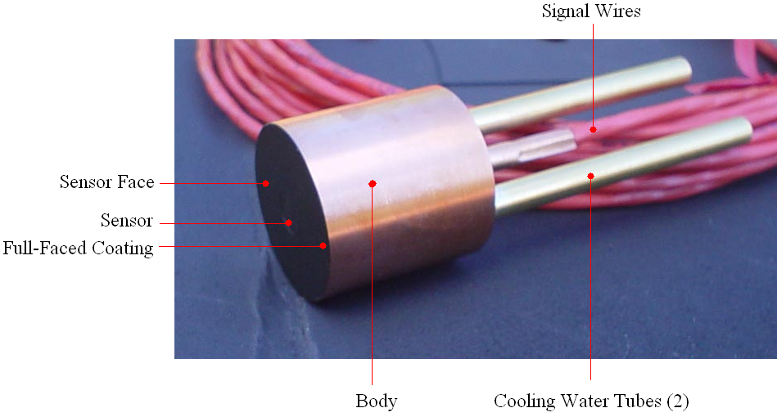
Aviation Heat Flux Calibration Standard
Heat Flux Gauge Specification
Type: Gardon or Schmidt-Boelter HFG
Nominal Range: 0 – 5 W/cm² (0–4.4 BTU/ft²*sec)
Construction: Continuously water-cooled, cylindrical, one inch diameter body. A mounting flange attached to the body is permissible. Cooling water tubing length and diameter may vary.

Slide 9
Aviation Heat Flux Calibration Standard
Coating: The HFG must have a thin, full-faced, opaque coating of high-quality, high-temperature, ultra-flat black paint having a diffuse surface finish.
Several very light coats of paint are sprayed on the sensor face and permitted to dry between coatings.
The nominal dry film thickness of the coating on the sensor face shall be 5 mils or less.
The coating on the HFG to be calibrated must be removed and replaced prior to calibration.
Cooling Water: The HFG cooling water temperature, pressure and flow shall be maintained within the manufacturer’s recommendations.
It is not recommended to connect cooling water circuits in series.

Slide 10
Aviation Heat Flux Calibration Standard
Data Acquisition System Specification
The data acquisition system must have a minimum scan rate frequency of 4 Hz, a measurement uncertainty less than ± 0.01 mV (at 95% confidence, k=2) and be able to collect the two HFG signals within 1⁄10th of a second of each other.
The calibration software must convert millivolt data of a Working HFG to that of a Standardized gauge (having a known slope) to generate a calibration factor.
Calibration data between the range of 1 W/cm² (0.88 BTU/ft²*sec) and 4 W/cm² (3.52 BTU/ft²*sec) is used to linearize the slope. Zero offset data are not to be considered, and data beyond these two ranges must be omitted.
Calibration Interim
Secondary Standard HFG: The Secondary Standard HFG must be calibrated at NIST using their heat flux calibration service at least once every 5 years.

Slide 11
Aviation Heat Flux Calibration Standard
Calibration Interim continued
The Secondary Standard HFG: This HFG should not be used for anything other than calibrating transfer standard sensors.
Transfer Standard HFG: The Transfer Standard HFG must be calibrated by a Secondary Standard HFG at least once every year.
Working HFG: The Working HFG must be calibrated by a Standardized HFG at least once every year.
Data Acquisition System: The data acquisition system must be calibrated to NIST traceable voltage sources at least once every year.

Slide 12
Aviation Heat Flux Calibration Standard
Laboratory Environment
The air circulating around the apparatus must be draft-free (stagnant). The ambient laboratory dew point must be lower than 5°F below the cooling water temperature (for example, at 73°F, the ambient relative humidity shall be less than 80% to achieve this). This is to prevent condensation from forming on the sensor face.
Calibration Set-up
Method: Incident heat flux, vertical orientation.
Gauge Type: When transferring a calibration from a standardized gauge to a non-standardized gauge, both gauges to don’t have to be of the same type.
Mounting HFGs for Calibration: When securing the cylindrical one inch body of the instruments into position for calibration, avoid obstructing the sensors’ 180° field of view of the radiant heat source.

Slide 13
Aviation Heat Flux Calibration Standard
Mounting Fixture: If more than one HFG mounting fixture is used they must be identical in construction.
HFG Position: Mount a Standardized HFG and the unit to be calibrated in the vertical orientation.
Each gauge must be located an equal distance or within 0.002 inches of each other with the sensor face parallel to the radiant heat source.
Cooling Water: Ensure there is proper water flow to each sensor before initiating the HFG exposure to radiant heat.
Condensation: Ensure that there is no condensation that occurs on either sensor face prior to, or during, the calibration procedure.
Electrical: Connect the signal wires of each HFG to the data acquisition system ensuring that each HFGs polarity is set correctly with an increase in heat flux corresponding to an increase in millivolt signal.

Slide 14
Aviation Heat Flux Calibration Standard
Calibration Procedure
STEP 1
Measure the zero flux voltage and resistance of the HFGs.
STEP 2
Apply radiant heat to both sensors until the Standardized HFG reading reaches 5 W/cm². A gradual heat radiance increase from 0 to 5 W/cm² must occur within 45 ± 5 seconds.
STEP 3
Immediately begin decreasing the radiant heat. A gradual cool-down rate from 5 W/cm² to less than 1 W/cm² must occur over a minimum time period of 90 seconds.

Slide 15
Aviation Heat Flux Calibration Standard
Calibration Procedure (continued)
STEP 4
At the upper threshold of 4 W/cm², begin recording signal data continuously for both HFGs.
STEP 5
At the lower threshold of 1 W/cm², stop recording signal data.
STEP 6
Repeat STEP 1, verifying the HFGs return to previous conditions and document results.

Slide 16
Aviation Heat Flux Calibration Standard
Requirements
ANALYSIS
Multiply the Standardized HFG millivolt values by the known slope and calculate the heat-flux level for each data point.
A least squares fit procedure is performed using the calculated heat flux and the Working HFG millivolt values: ΔY (Units)/ΔX (mV)
Where:
Y = Standardized HFG (W/cm2 or BTU’s/ft2*sec)
X = Working HFG (millivolts)

Slide 17
Aviation Heat Flux Calibration Standard
Reproducibility Requirement
It must be shown that if the locations of the two HFGs are interchanged and the calibration is repeated, the difference in the successive calibration factor must not be greater than +/- 3%.
If the calibration results are within range, use the average as the calibration factor.

Slide 18
Aviation Heat Flux Calibration Standard
Required Reporting Parameters
General:
Facility Conducting Calibration
Customer (Lab performing future tests with the Working HFG)
Calibration Date
Calibration Expiration Date

Slide 19
Aviation Heat Flux Calibration Standard
General (Continued):
HFG cooling water
  Temperature
  Pressure
  Flow rate
XY Plot or Raw Data Table
Linearity of HFG mV Signals During Calibration (Confidence Level)
Calibration Traceability
Calibration Certificates of Devices Used

Slide 20
Aviation Heat Flux Calibration Standard
Working HFG Information:
Manufacturer
Part number / Serial number
Sensor type
Sensor coating material
New calibration factor (W/cm²)
Sensor voltage and ohm reading between signal leads at zero flux (Pre/Post)

Slide 21
Aviation Heat Flux Calibration Standard
Working HFG Information (Continued):
Prior Calibration Data (If available)
Date
Calibration Factor (W/cm²)
Facility Where Calibration was Conducted
% Change in Calibration Factor
Traceability Records to a Standardized HFG

Slide 22
Aviation Heat Flux Calibration Standard
Standardized HFG Information:
Manufacturer
Part number / Serial number
Sensor Type
Sensor Coating Material
Calibration Factor (W/cm²)
Sensor Voltage and Ohm Reading Between Signal Leads at Zero Flux (Pre/Post).
Calibration Date of Standardized HFG
Traceability Records to NIST Primary Standard HFG

Slide 23
Preliminary Comparative Test Data
Overview
Traditional calibrator / Prototype heat flux calibrator
Calibration procedures
Results and observations

Slide 24
Overview
Compare calibration results, repeatability and reproducibility using the traditional calibrator and new prototype design.
Heat transfer methods:
  Traditional – Graphite plate
  Prototype – Halogen bulbs (T3; 500W)

Slide 25
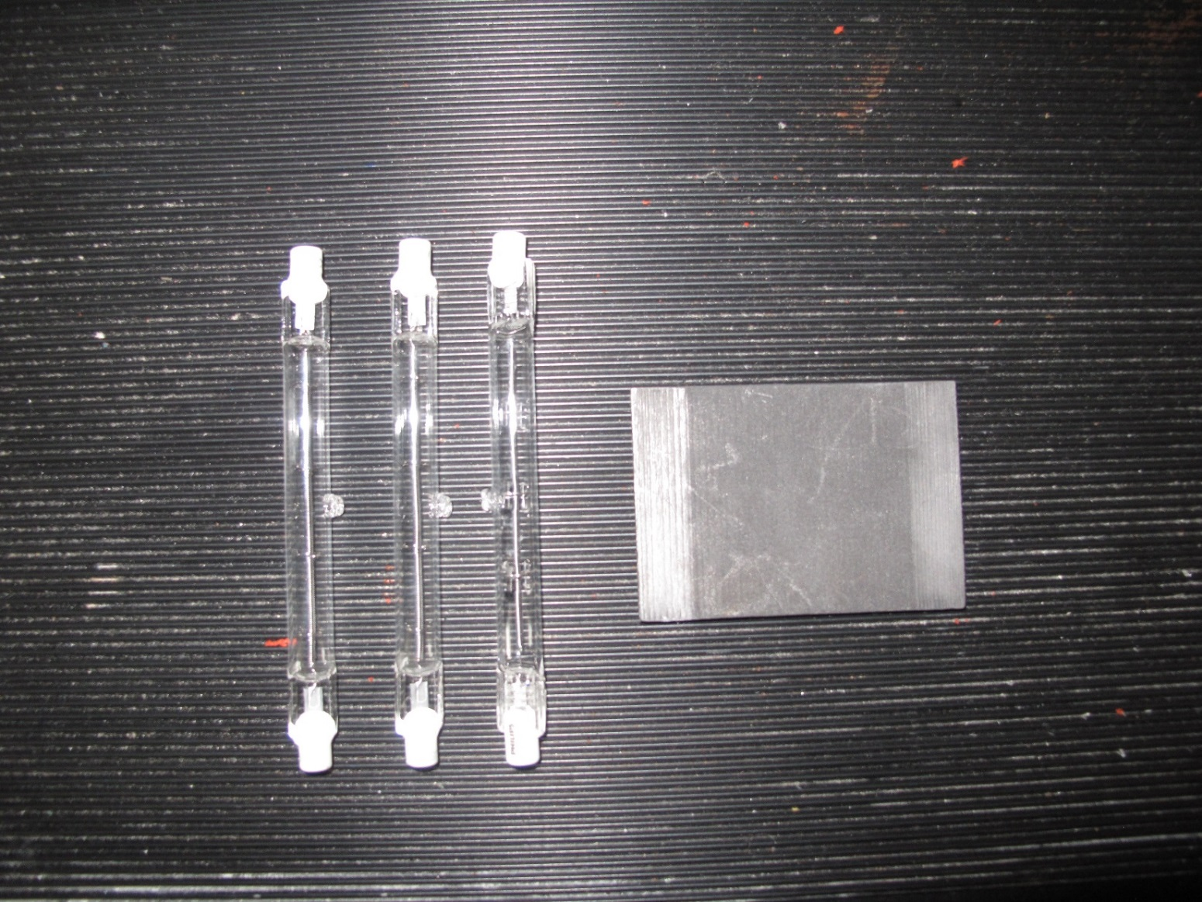
Heat Flux Gauges

Slide 26
Heat Flux Gauges

Slide 27
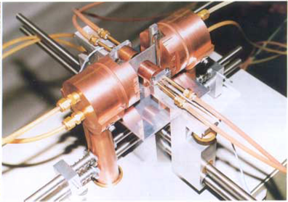
Traditional heat flux calibration apparatus

Slide 28
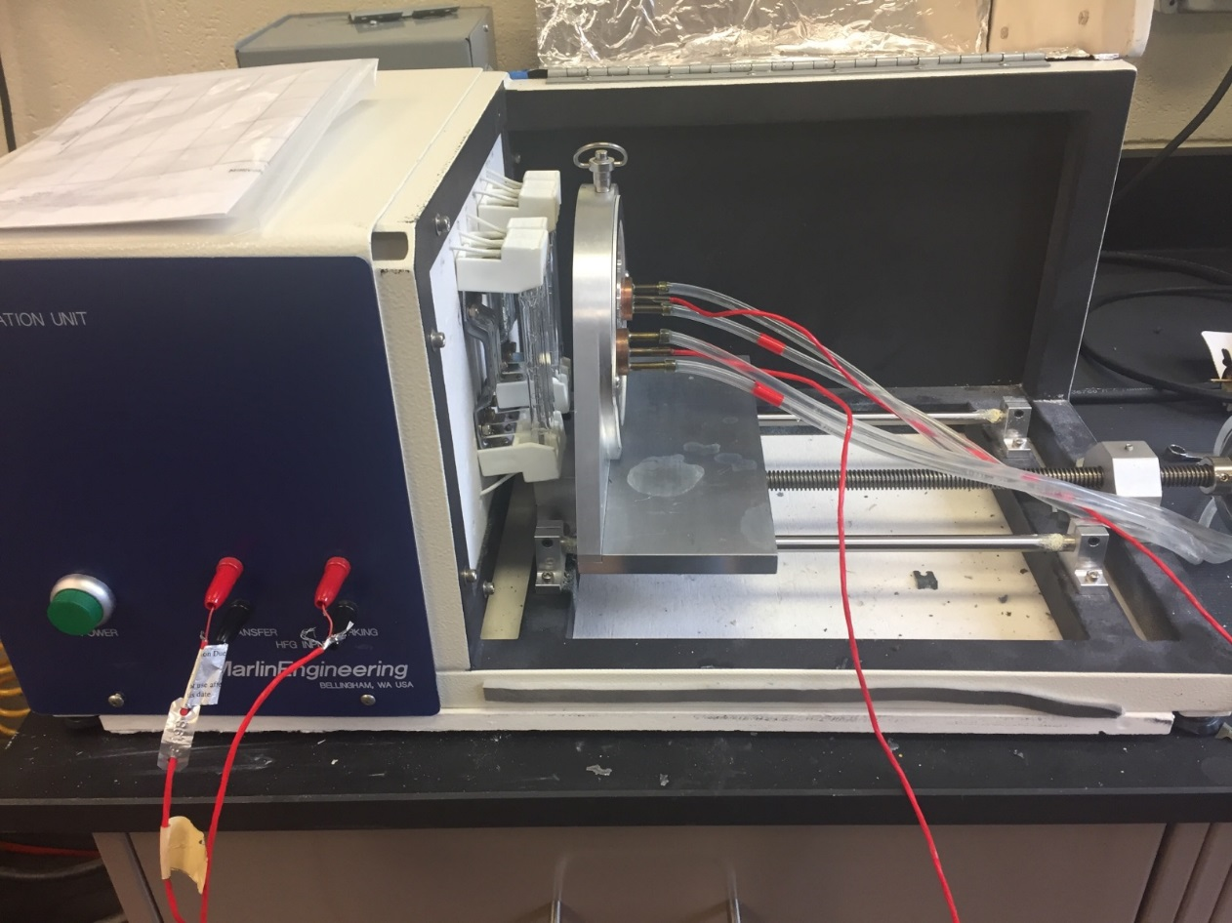
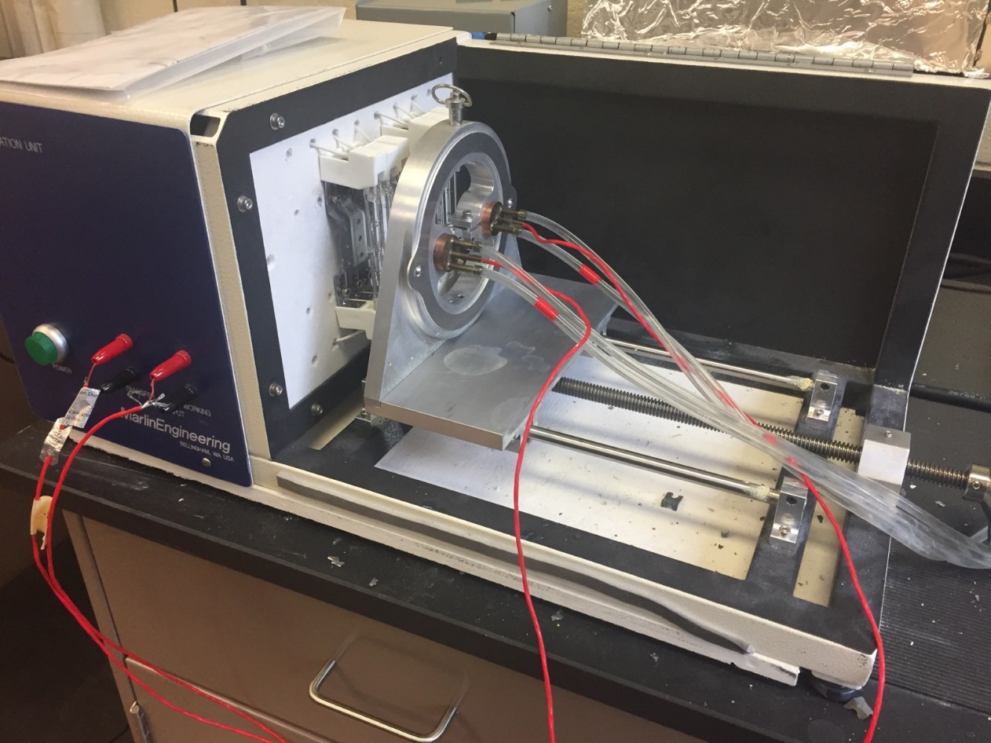
Prototype heat flux calibration apparatus

Slide 29
Calibration Procedures – Traditional Unit
The Reference Gage was calibrated by NIST.
Traditional unit uses a Graphite plate heat transfer method.
Power is ramped up to maximum output of standard gage.
  Approximately 45 seconds
Power is turned off and recorder started.
Data is recorded for approximately 3 minutes during cool. down (uncontrolled cooling rate)
Linear fit of data points is used to calculate the calibration factor.

Slide 30
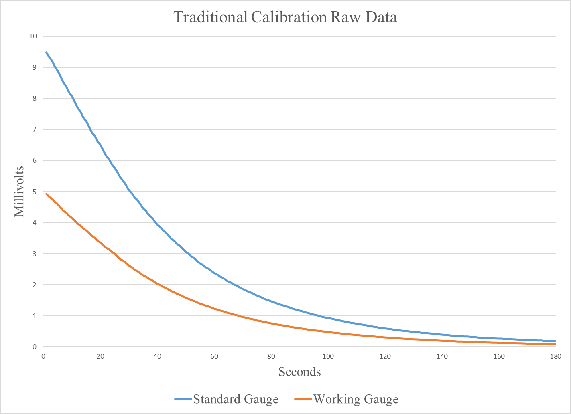
Traditional Heat Flux Calibrator

Slide 31
Calibration Procedures – Prototype Unit
The same Standard Gage is used.
Prototype unit uses Halogen bulbs as heat transfer method.
Recorder is started and power is ramped up to maximum output of standard gage.
  Approximately 45 seconds
Power is ramped down at a controlled rate.
Data is recorded between 4 and 1 W/cm².
  Approximately 90 seconds
Linear fit of data points is used to calculate the calibration factor.

Slide 32
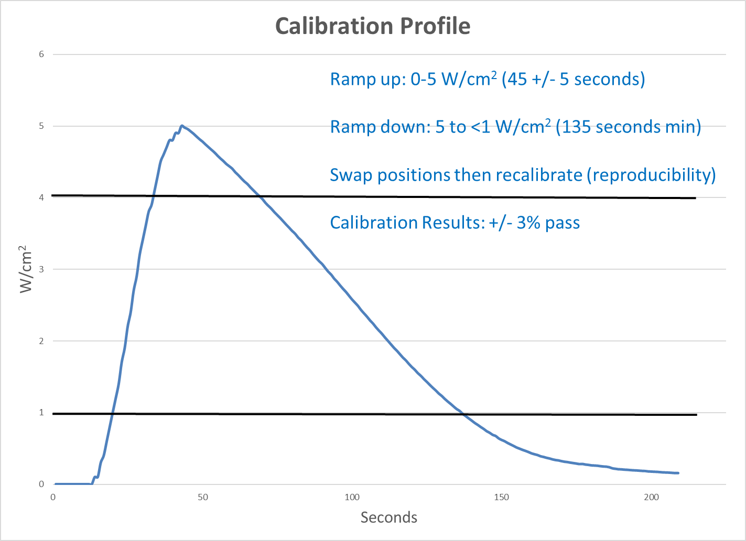
Prototype Heat Flux Calibrator

Slide 33
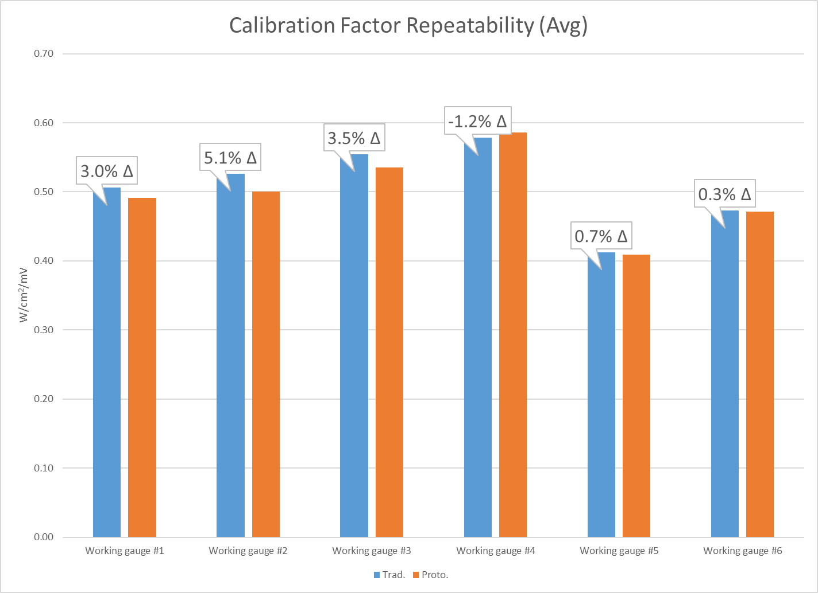
Comparative Test Results

Slide 34

Comparative Test Results

Slide 35
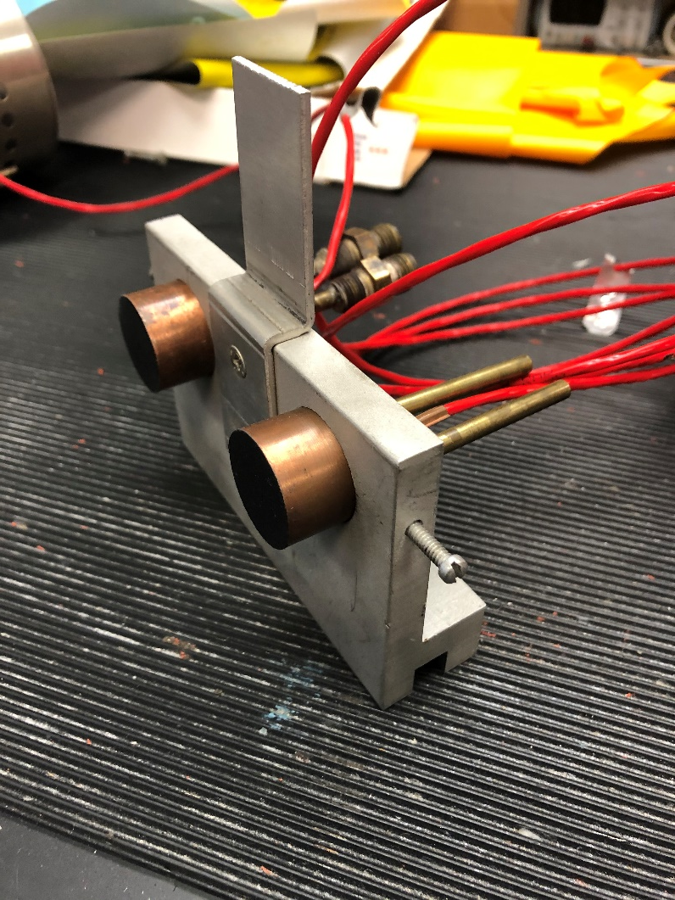
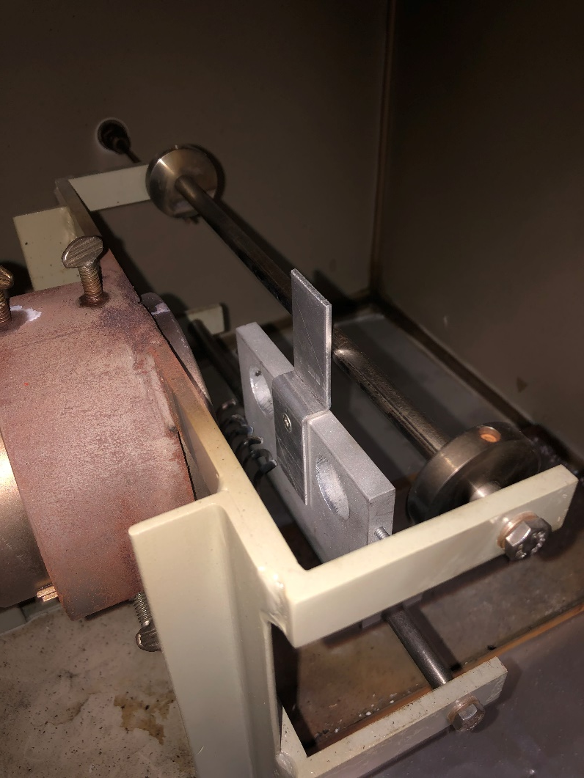
Comparative Test Results
Side by Side Mounting Fixture
Mounting Fixture in NBS Chamber

Slide 36
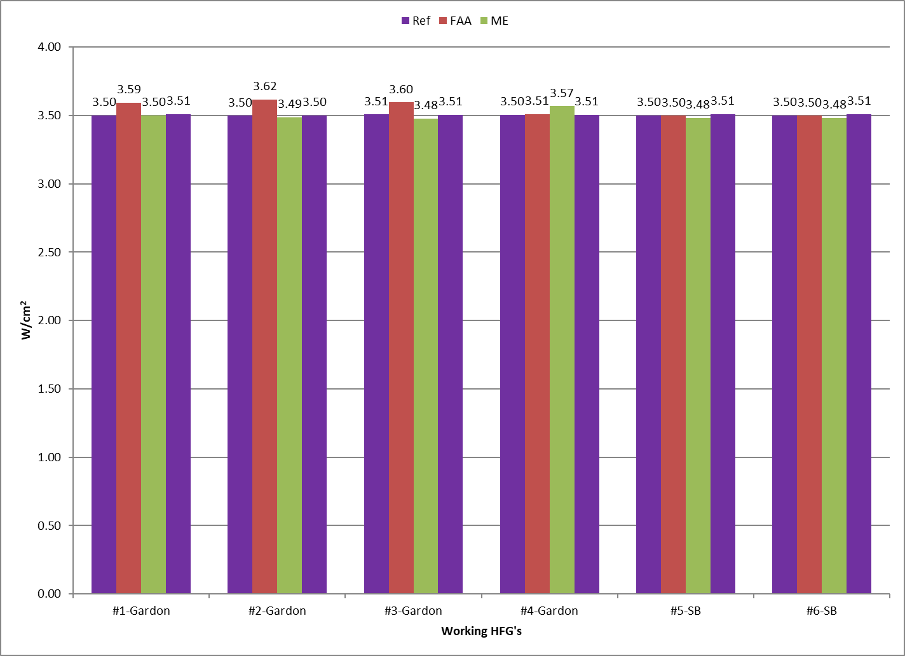
Comparative Test Results

Slide 37
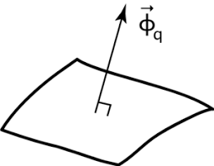
Questions?

